Slide 1
Renewable Energy Vehicles’ User Interface
Implementation of a Raspberry Pi
&
Engine Audio Replication System
By Gabriel Feng
Notes:
Good evening my name is … and my project deals with the …

Slide 2
Vehicular Safety Through Ergonomics
Human Machine Interaction (HMI)
Physical ergonomics
Road Traffic (Vehicle Standards) Rules 2002
BMW
Image: Niedermaier et al. 2009
Notes:
In this project the main concern is the human machine interaction factor.
This can be grouped into two parts, Physical ergonomics and Mental ergonomics.
Firstly, physical ergonomics. I
In Western Australia we have in place a set of rules, the Road Traffic Rules 2002, to prevent electronic devices from being the source of hazard in a vehicle.
It disallows visual display units from being visible to the driver, with the exception of a driver’s aid. However it is not explicitly specified what a driver’s aid is.
It does specify that the driver’s aid cannot obstruct a driver’s view of the road or impede movement.
BMW has a neatly organised system that deals with their HMI.
They split their control panel into 4 sections, key driving functions to the left while auxiliary functions are to the right.
Displays are placed in the top section and controls in the bottom section.

Slide 3
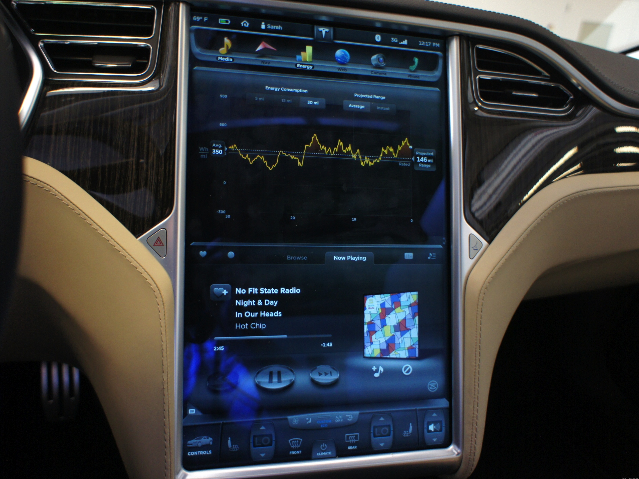
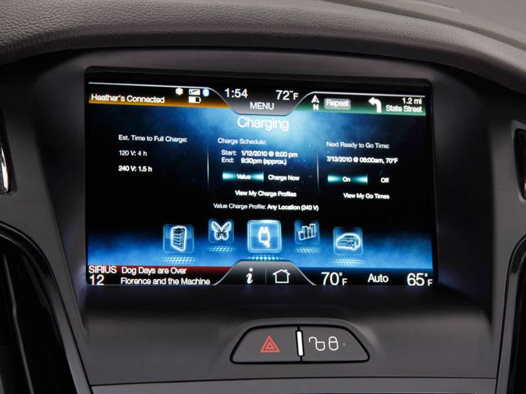
Vehicular safety through ergonomics
Mental ergonomics
Drivers still in full control of the vehicle
Distractions are dangerous
UIs are distractions
UIs are potentially dangerous
Images: http://i.i.cbsi.com/cnwk.1d/i/tim2/2013/05/14/Tesla_Nvidia_tech-008.JPG, http://b.img-zemotoring.com/media/news/2011/01/ford-myford-touch-17.jpg
Notes:
As explained earlier ergonomics does not only apply physically but also mentally.
As of now, almost all vehicles are non-autonomous, drivers are still in full control of their vehicle.
We can agree that distractions to the driver of the vehicle is dangerous, especially while in motion.
User interfaces are to a certain extent distractions.
As such Uis are potentially dangerous depending on how they are implemented.
The top picture is the UI of the Electric Tesla Roadster, although the large display is aesthetically pleasing, the amount of information can be distracting to the driver.
The bottom picture is of Ford’s Myford touch system, this time the information seems to be over crowding the display and could increase glance time to find key information.

Slide 4
Objectives
Improve the Graphical User Interface (GUI) for both vehicles
Improve EyebotM6’s (Getz) reliability
Port Lotus’ GUI onto Raspberry Pi (RPi) and modify it accordingly for Getz
Install RPi into both vehicles
Re-implement Engine Audio Replicating System (E.A.R.S.)
Notes:
The objectives for this project was to ……

Slide 5
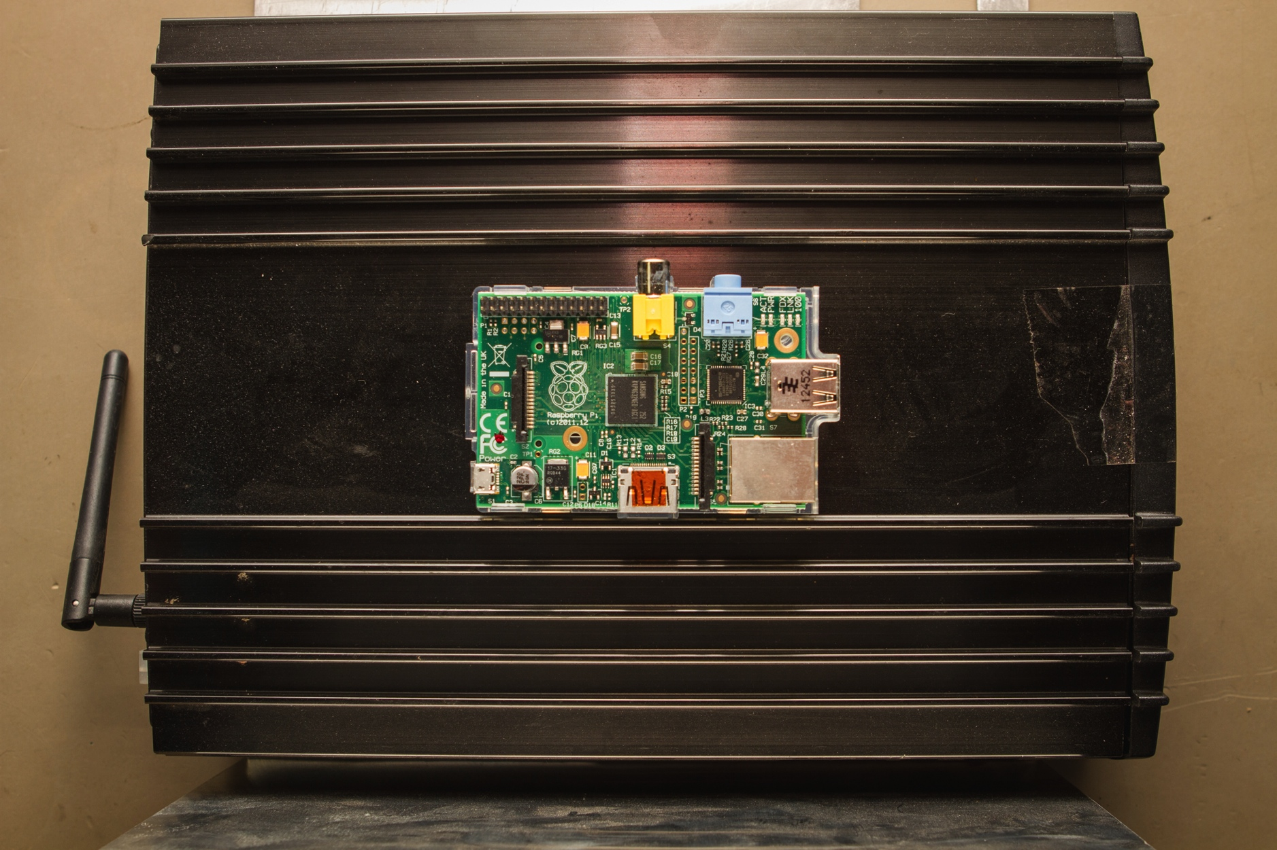
Purpose
A well designed UI is an attribute to vehicular safety
Cost and size
Pedestrian safety
Notes:
Due to the facts explained earlier we need to have a well designed UI that allows the driver to view key information quickly, and to be able to interact with the interface with as little effort as possible.
The raspberry pi is used due to it’s cost and size. The EyebotM6, which is designed in UWA, costs approximately $1000, while the raspberry pi costs approximately $50.
The size of the raspberry pi is slightly smaller than the Eyebot, but significantly smaller than the Car PC being used in the Lotus.
It is also less noisy than the car pc due to the lack of a fan.
The E.A.R.S is an effort to improve pedestrian safety around Evs.
I will touch on that more later.

Slide 6
Process
Initially, fix and improve EyebotM6 then move onto RPi then E.A.R.S.
Objectives changed to both vehicles using RPi
First, port the Lotus’ GUI
Next, standardise layout and improve upon GUI
Next, modify for Getz
Then modify in parallel
Install
E.A.R.S.
Notes:
The initial plan was to keep the Eyebot in the Getz and only replace the Car PC in the lotus with the Raspberry Pi, that however was changed so that both vehicles will use the same system.
As such I will not touch on improving Eyebot’s reliability in the presentation.
First, the lotus’ GUI will need to be ported from Windows to the Linux environment used by the RPi
Next is to standardise the layout and improve upon the gui
Next the GUI will have to be modified slightly for Getz due to certain factors such as lower resolution, different BMS and the Powermate
We can then modify the GUIs in parallel for additional changes after.
After installing the the RPi’s into the vehicles, we can then re-implement the E.A.R.S.

Slide 7
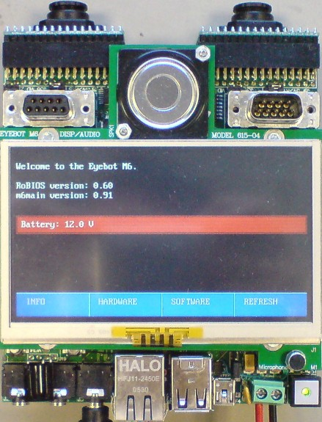
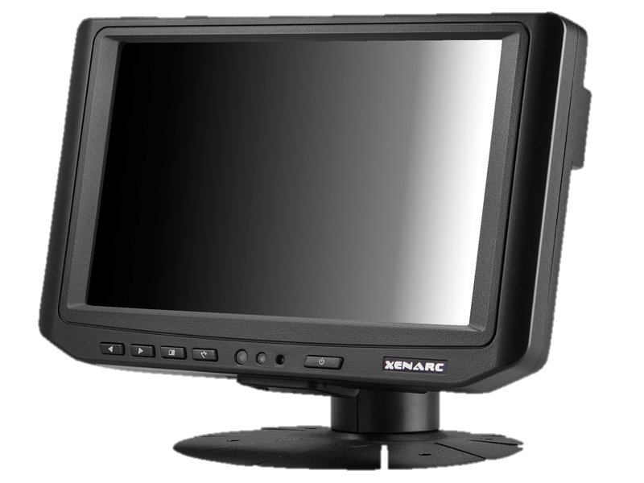
Previous Systems
REV Eco (Getz)
EyebotM6
4.3” Touchscreen
REV Racer (Lotus)
Voom Car PC
7” Touchscreen

Slide 8
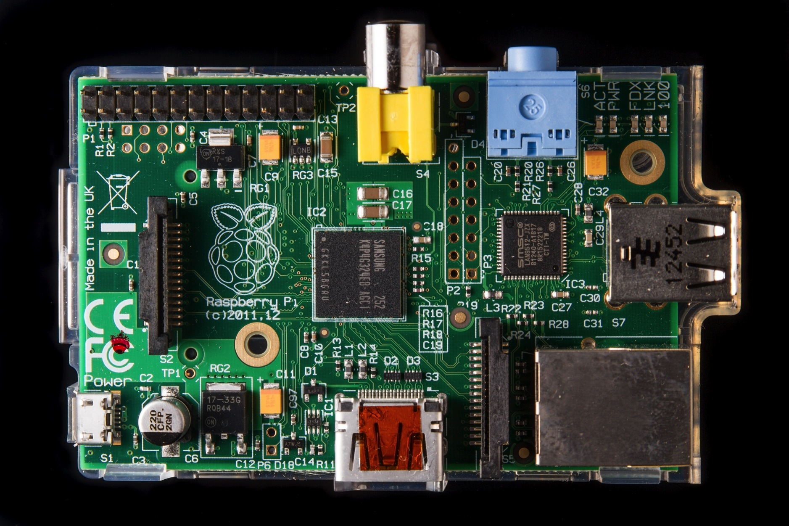
Current System
Raspberry Pi
700Mhz Broadcom BCM2835
ARM architecture
Boots from SD card
HDMI/ RCA Video output
2 USB ports
GPIO Pins
7” Screen
Powermate
Notes:
Now, the Raspberry Pi will be used in both vehicles.
The Rpi has a 700Mhz processor. It boots and runs using an SD card, has HDMI and RCA Video Output, 2 USB ports and several GPIO pins.
There’ll be 7” screens in both vehicles but a touchscreen for the Lotus, and a Powermate for the Getz

Slide 9
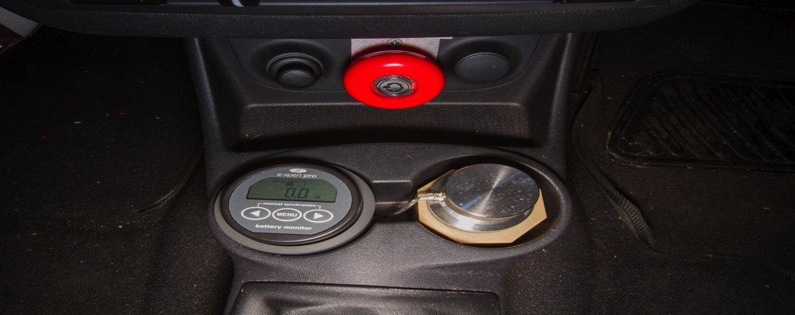
Powermate
Rotary knob with 6 inputs
Tactile and audio feedback
More limiting than touchscreen
Notes:
The 6 inputs are: Turning CW & CCW
Press
Turning CW & CCW while being pressed
Press and hold
The device provides a type of tactile feed back for the user, the disadvantage however is that it is stepless.
So for each digital step a click sound effect is played to provide the user with audio feedback.
It is more limiting than a touch screen but allows the user to navigate the simple GUI easily due to the audio feedback.

Slide 10
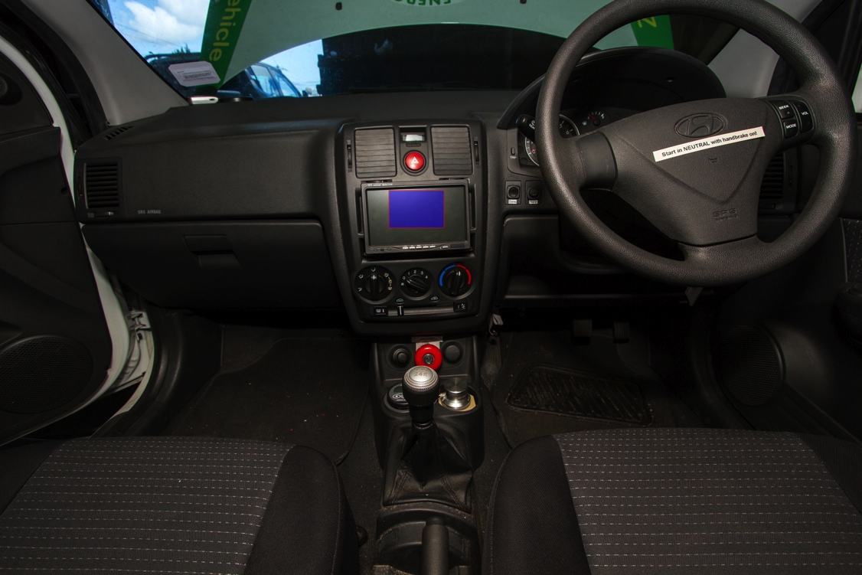
REV Eco Ergonomics
Same position as the old Eyebot’s screen
Not an ideal position.
Notes:
In this project we followed BMW’s footsteps and analysed the ergonomics of the REV Eco, Hyundai Getz.
The new screen in the same location as where the Eyebot’s screen was, as shown highlighted in the image.
This however is not an ideal position.

Slide 11
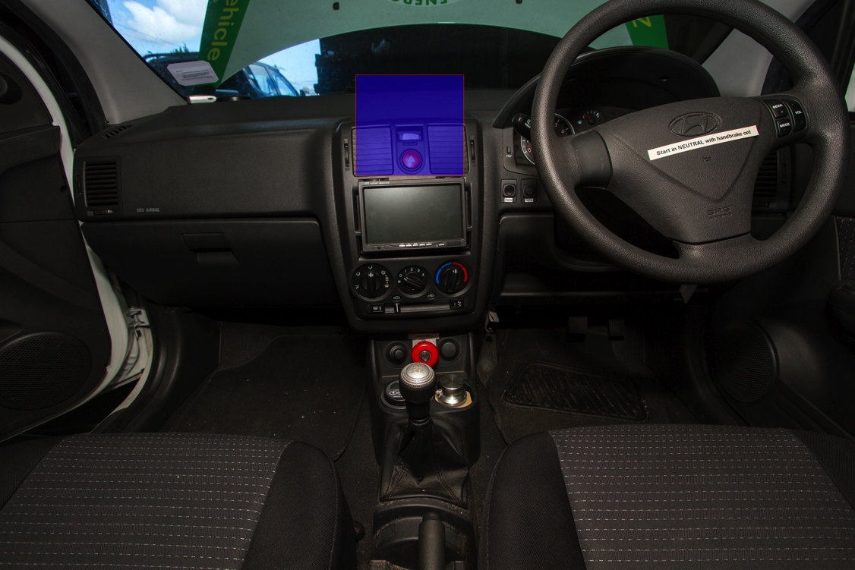
REV Eco Ergonomics
Same position as the old Eyebot’s screen
Not an ideal position
Ideal position as shown
Notes:
The ideal position is shown highlighted in the image, it is higher and brings the display closer to the view of the road .

Slide 12
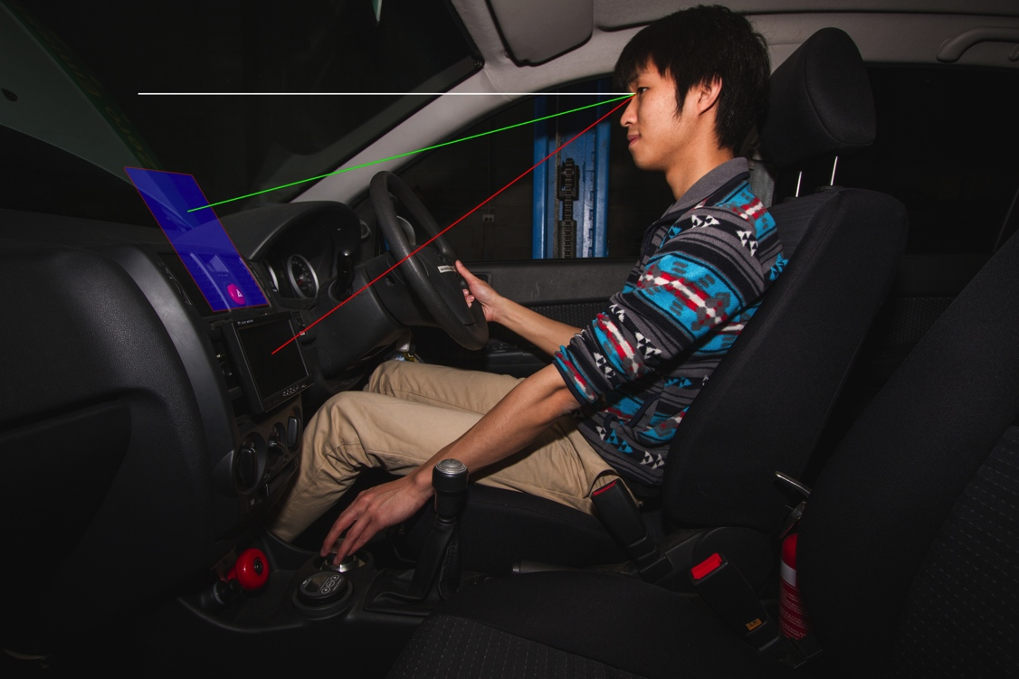
REV Eco Ergonomics
Notes:
The white line shows the line of sight for the driver looking at the road in front.
The red line shows the line of sight for the current location of the display.
The green line shows the line of sight for the optimal location of the display.

Slide 13
REV Eco Ergonomics
Same position as the old Eyebot’s screen
Not an ideal position
Ideal position as shown
Approximately halves the glancing angle
Notes:
We can see quite obviously that at the optimal location the angle for the line of sight is approximately halved.
It is straight forward to conclude that with the smaller angle, the driver takes less time to glance between the road and the display.
We can also reason that while looking at the display the road is within the peripheral vision of the driver or at least more so than current location.
However this cannot apply to everyone, different people have different vision capabilities.
The disadvantage of this location is that it requires major work to the vehicle’s interior in order to mount the display.
Also depending on the height of the person a higher mounted display may begin to obstruct the view of the road. This would violate the Road Traffic Rules.

Slide 14
REV Eco Ergonomics
Ideal position as shown
Approximately halves the glancing angle
Driver able to reach Powermate
Might not apply to everyone
Notes:
Now take note that the driver is able to reach the Powermate without lifting his back off the seat.
However, again this might not apply to everyone.
We can see that the arm is extended fully and someone else might not be able to reach the device.

Slide 15
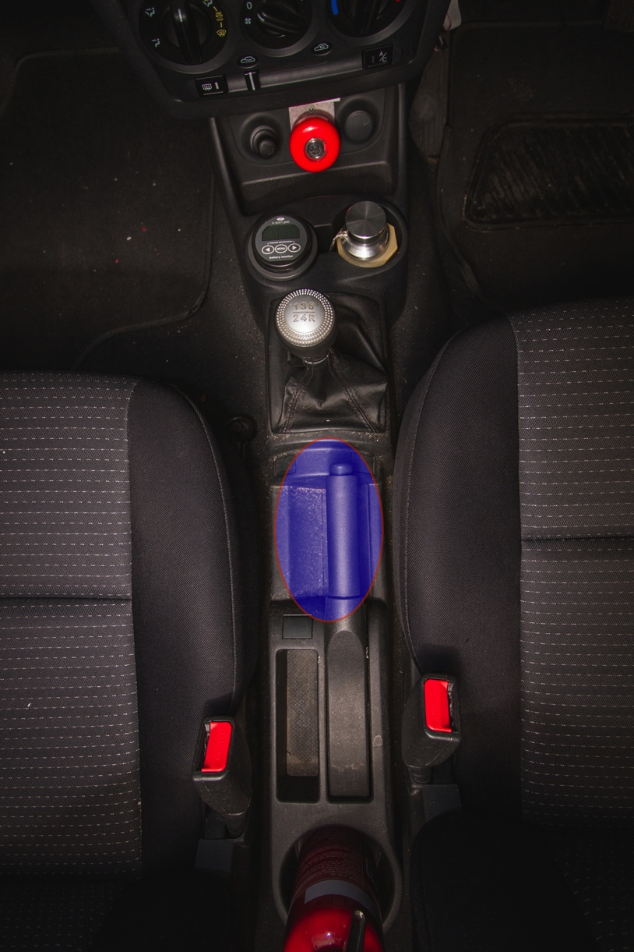
REV Eco Ergonomics
Driver able to reach Powermate
Might not apply to everyone
Better location for Powermate
Disadvantage of retrofitting
Notes:
This image shows a better location for the Powermate, but we can obviously see this area is currently utilised by the handbrake highlighting the disadvantages of retrofitting.

Slide 16
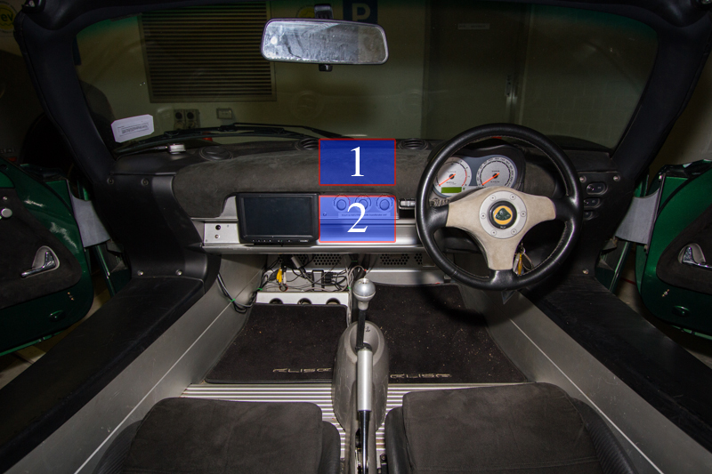
REV Racer Ergonomics
Touchscreen stayed in the same position
Not ideal
Notes:
Similar to the Getz the Lotus keeps the display in the same location. Again this is not ideal.
The current position requires a significant rotation of the head to the left in order to clearly see the display.

Slide 17
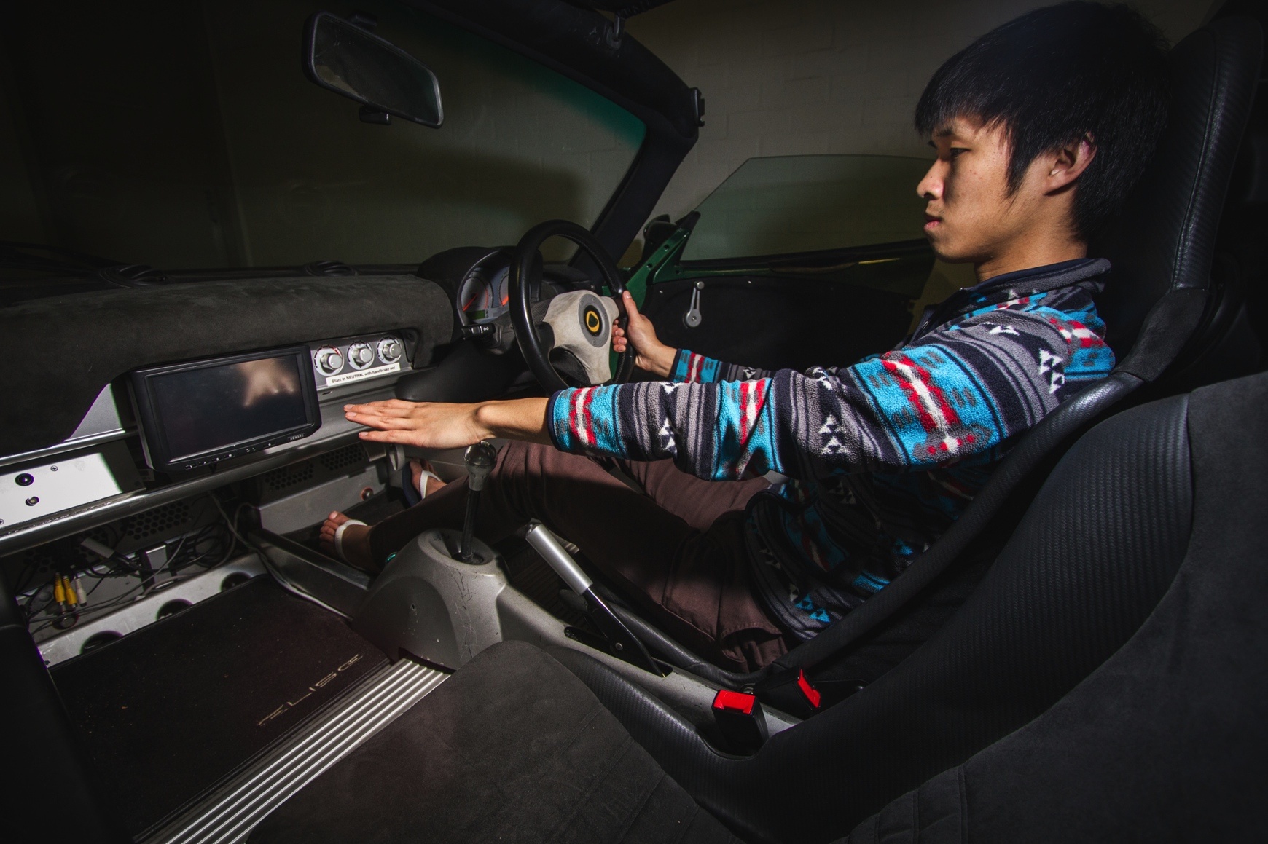
REV Racer Ergonomics
Notes:
Take note that the driver is not able to reach the right hand side of the touchscreen.

Slide 18
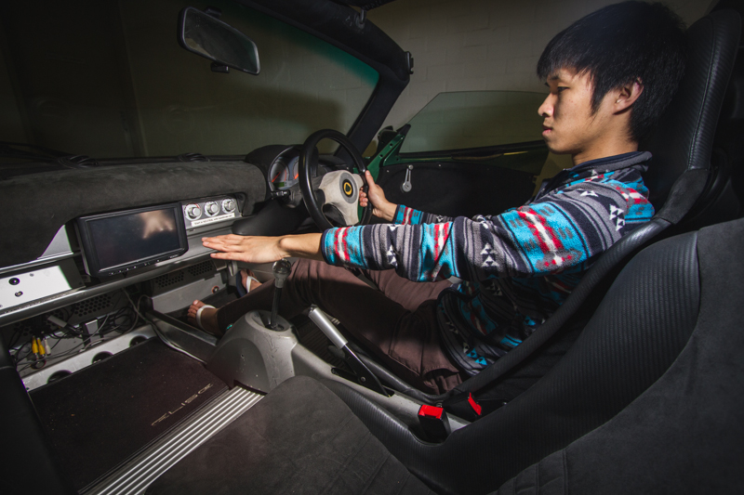
REV Racer Ergonomics
Touchscreen stayed in the same position
Not ideal
Not able to reach without lifting shoulder off the seat
Might not apply to everyone
Notes:
This means that the driver will have to lift his back from the seat to operate the touch screen, this is not desired.
Similarly this might not apply to everyone.

Slide 19
REV Racer Ergonomics
Not able to reach without lifting shoulder off the seat
Might not apply to everyone
Ideal positions as shown
Easier to reach and again reducing glance angle
Notes:
In this image,
Position 1 shows the optimal location, with similar reasons as before.
Position 2 shows the next ideal location, bringing the screen closer and within reach.
The Lotus also suffers from the same issue with the Getz in that major work is required if the display is to be mounted at the optimal location.

Slide 20
Driver Distraction
Japan Automobile Manufacturer’s Association
Objectively measured
Total glance time
Vehicle’s lateral displacement
Speed
Steering angle
Accelerator operation
Lateral acceleration
Touchscreen, joystick, remote control and rotary knob
Notes:
Now onto the software side of HMI.
In order to determine how the total glance time correlates to driver distraction on actual roads, the Japan Automobile Manufacturer’s Association objectively measure several factors while drivers operate a navigation system using different operating methods.
Some of the tasks required by the driver were as complex as 12 steps.
They concluded that in-vehicle system operation does not cause stress and does not affect vehicle control regardless of operating method as long as the TGT does not exceed 8s.
Fortunately our GUI does not require any complex navigation.

Slide 21
Previous REV Eco GUI
Written in C++
Battery state and current
Money saved
Maps
Trip computer
Logger
Digital I/O
Image: Trepp 2011, p.73
Notes:
The previous implementation of the GUI in the Getz was …

Slide 22
Previous REV Eco GUI Issues
Colour
Buttons ineffectively laid out
Digital I/O not being used effectively
Size
System get corrupted
Location
Expensive
Image: Trepp 2011, p.73
Notes:
The issues with it were poor colour choice, it was difficult to see the text in certain conditions.
The buttons were ineffectively laid out.
For example home button does not lead you to the main page with the battery status but rather leads to a page with other buttons.
The size of the screen meant smaller fonts, or overcrowding of information.
The Eyebot’s power gets cut, when the ignition is turned off, the repeated action sometimes corrupts the system image.
The Eyebot is located behind the center fascia, making it difficult to work on.
As mentioned before it is also very expensive

Slide 23
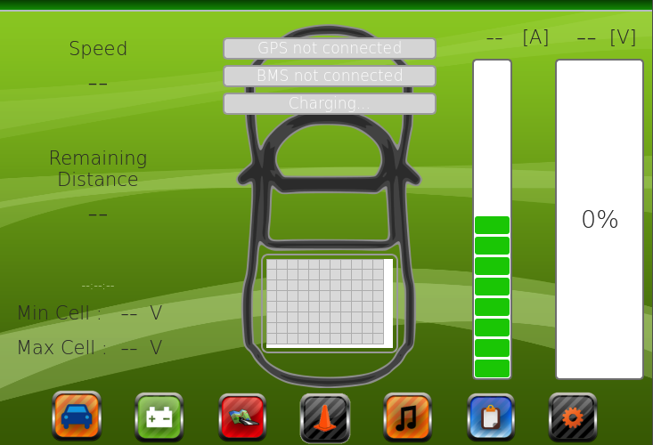
Previous REV Racer GUI
Written in C++ for Windows, Qt library
Detailed battery view
Maps
Music
Main Roads twitter feed
Trip computer
Logger
Notes:
In the previous Lotus’ GUI implementation, it was…

Slide 24
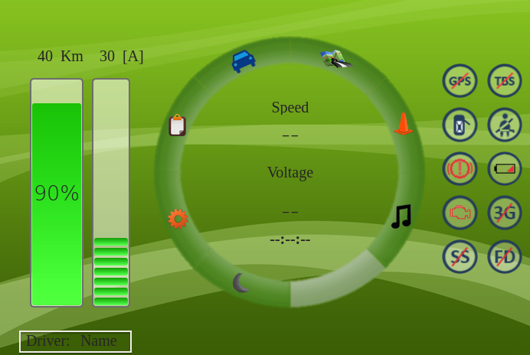
Redesigned GUI
Used on both vehicles
Notes:
This is the redesigned GUI that is currently used in both vehicles, the circular layout is due to Powermate’s circular design and rotary action.
I will now quickly describe the new functionalities in the GUI

Slide 25
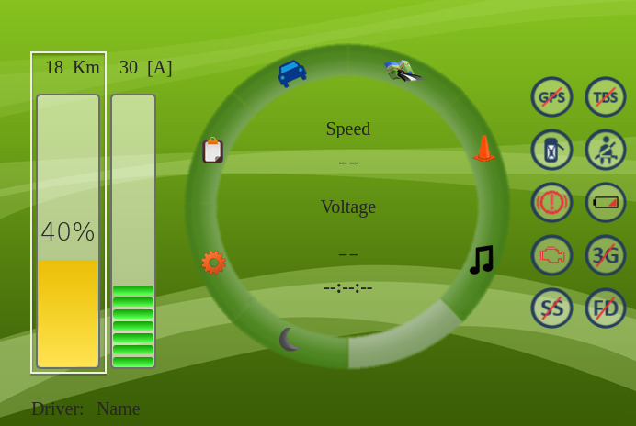
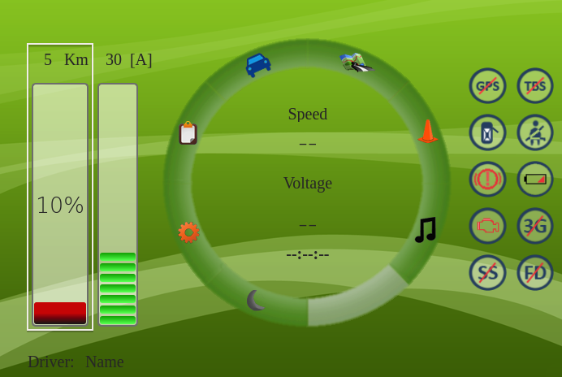
Functionality
Colour indication for battery charge
Icons
Notes:
The batteries’ state of charge is now colour indicated, allowing the driver to quickly assess the information.
The Icons on the right rely on the vehicle sensor’s digital states. The Getz currently has wires available where the states can be read.
However due to the limitations of the Raspberry Pi an external module for I/O is recommended and still needs to be implemented.
The lotus will require further work to be able to tap into the states of the vehicle.

Slide 26
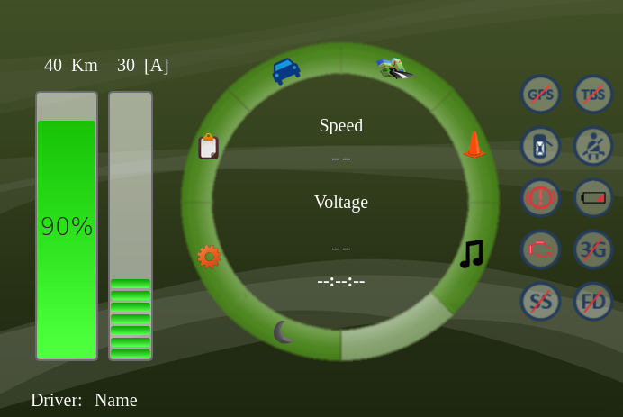
Functionality
Colour warning for battery charge
Icons
Night view
Notes:
A night mode aids the driver’s night vision by reducing the brightness in the cabin of the vehicle at night.
It is currently fixed to change at 7pm and 6am.
Without too much difficulty it is possible to change to night mode automatically if a light sensor was added to the vehicles.

Slide 27
Functionality
Colour warning for battery charge
Icons
Night view
Different info views
Notes:
The different info views only applies to the Getz. It gives the driver quick access to condensed information.

Slide 28
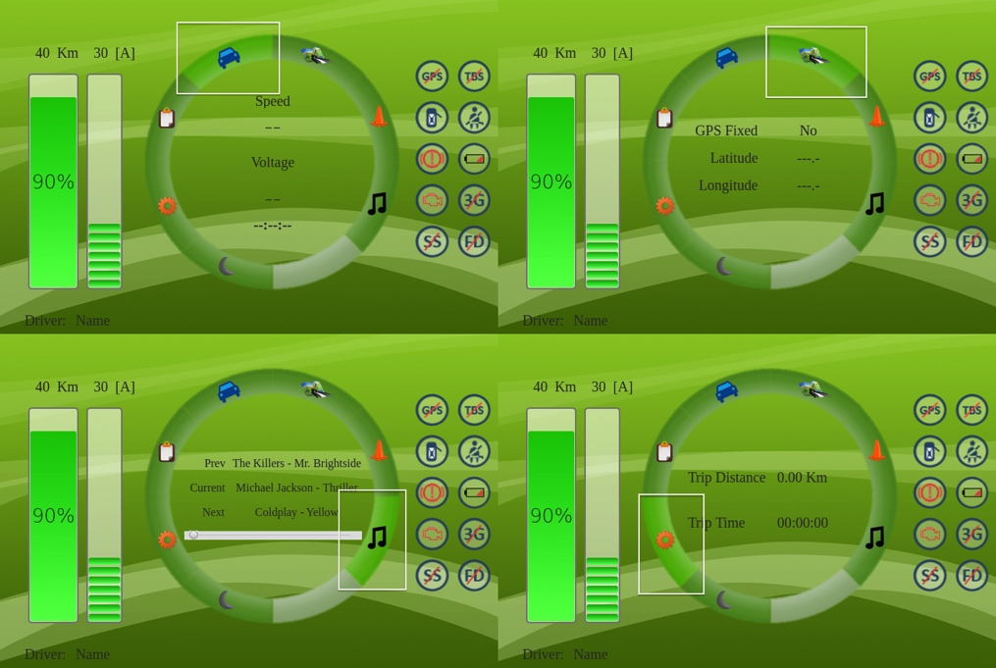
Functionality
Notes:
Can see that the information changes based on which button currently has the focus.

Slide 29
Functionality
Colour warning for battery charge
Icons
Night view
Different info views
Larger map display
Notes:
A larger map display is also implemented

Slide 30
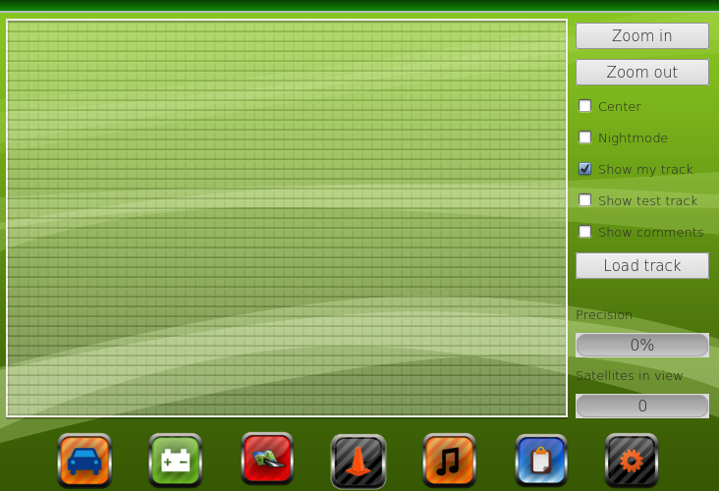
Functionality
Notes:
The textured area shows the area of the map widget in the previous implementation.

Slide 31
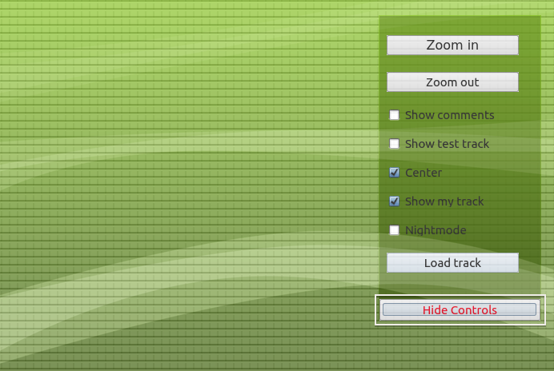
Functionality
Notes:
We can now see that the textured area covers the complete area of the screen.
The user is also able to hide and show the control panel to get the full view of the map

Slide 32
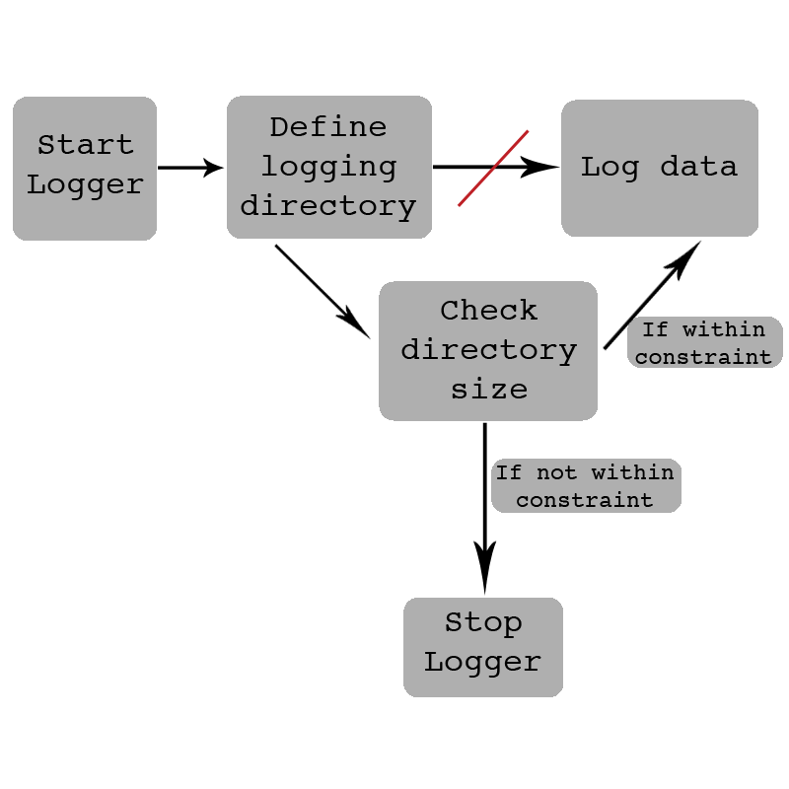
Functionality
Larger map display
Directory size constraint
Notes:
A check has been added to the logging functionality. Previously the logger will attempt to log the data and stop logging if it fails.
Now however the logger will check to ensure that the directory it is storing to is within some specified size constraint.
If it does not satisfy the constraint, it will stop the logger and display the appropriate message.

Slide 33
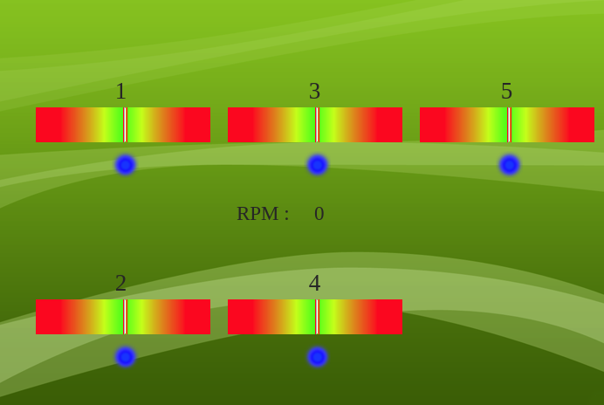
Functionality
Larger map display
Directory size constraint
Rev-matching aid
Notes:
The rev-matching aid is crucial since both vehicles do not use a clutch.
The lines for each bar shows a percentage difference between the engine speed and the speed of the corresponding rotating gear.
When the engine speed matches the rotating speed of a gear the line for that bar will be in the middle and the driver can know that the gear change will be successful.

Slide 34
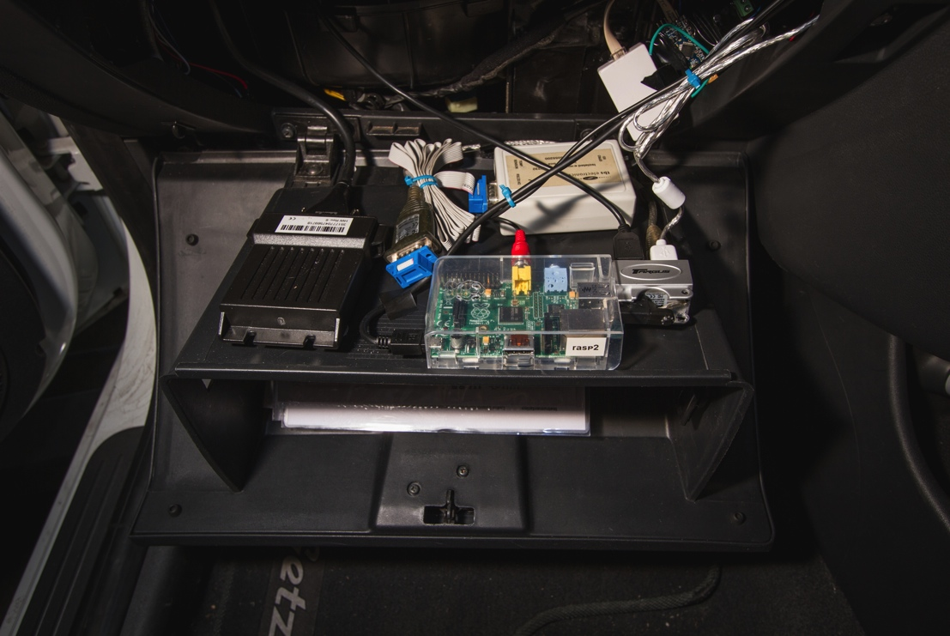
Installation-REV Eco
Behind glovebox
Relatively easy access to SD card
Notes:
For the actual installation of the Raspberry Pi, it is stored behind the glovebox in the Getz.
This provides relatively easy access to the SD Card while still being out of the way.

Slide 35
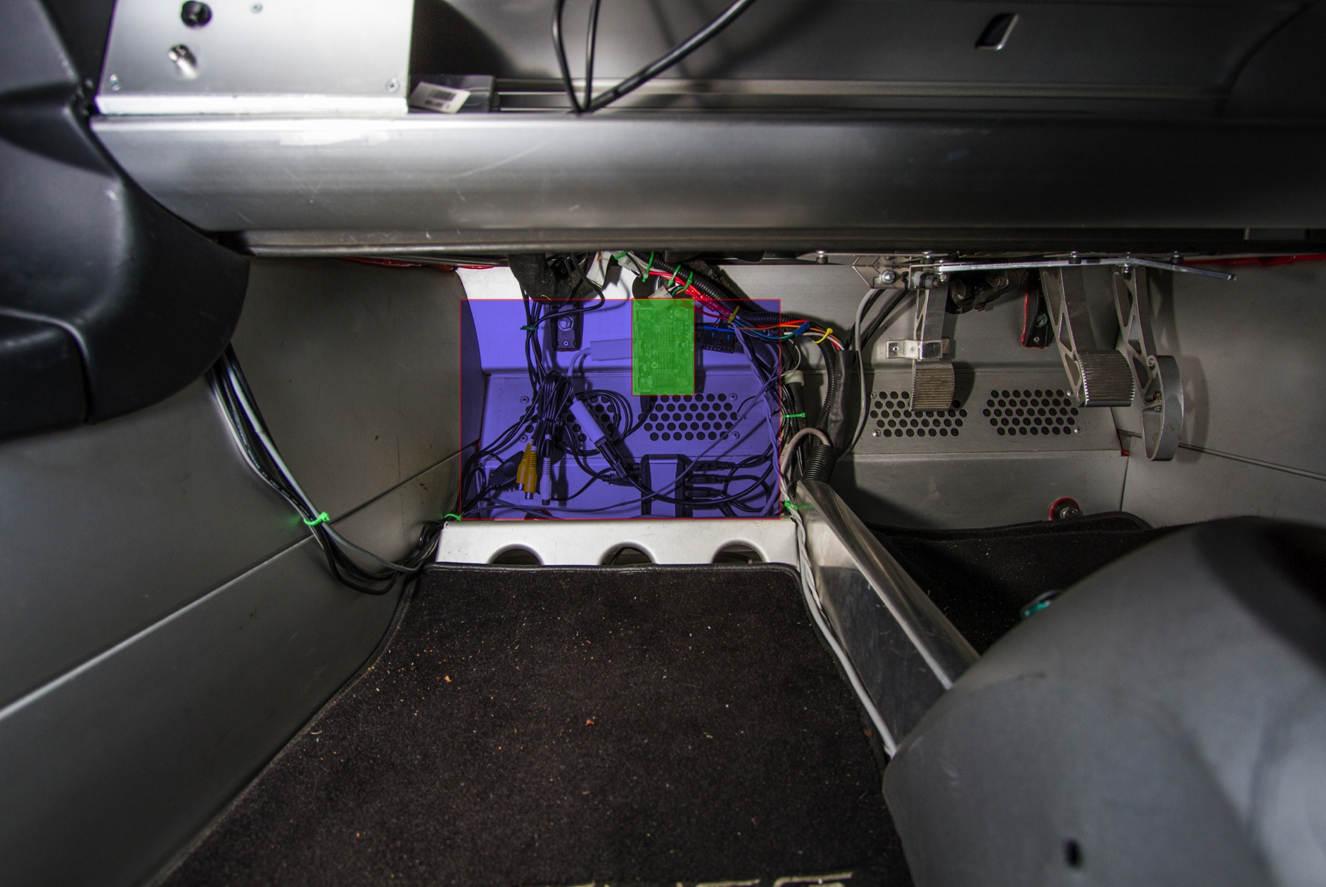
Installation-REV Racer
Notes:
The installation is a little more difficult due to the minimal interior of the car. It is installed in front of the passenger footwell. The blue highlighted area shows the location and size of the previous Car PC.

Slide 36

Installation-REV Racer
In front of passenger foot well
Easy access to SD card
Could be accidently kicked
Noise from Voom Car PC’s fan eliminated
Notes:
This location provides relatively easy access to the SD Card however it is possible that the raspberry pi can be kicked by the passenger.
Since the SD card protrudes from the pi, the SD card needs to be shielded to prevent damage if kicked accidentally.
Now that the Car PC is removed the only noise source from within the cabin is removed. It is dramatically quieter now.

Slide 37
E.A.R.S
Electric cars were found to produce less noise than petrol cars below 25km/h
Potentially hazardous to pedestrians, especially the visually impaired
E.A.R.S aims to alert surrounding pedestrians of the vehicle
Plays pre-recorded tracks of an engine at specific frequencies
Notes:
Finally the Engine Audio replicating system.
In previous studies Electric cars were found to produce less noise than petrol cars below 25km/h,
At higher speeds tyre noise contributes more significantly than engine noise.
This can be potentially hazardous, for example in a Car park area.
Also the visually impaired are trained to listen to audio cues for vehicles, and lack of an audio cue for a gap in traffic.
E.A.R.S aims… …

Slide 38
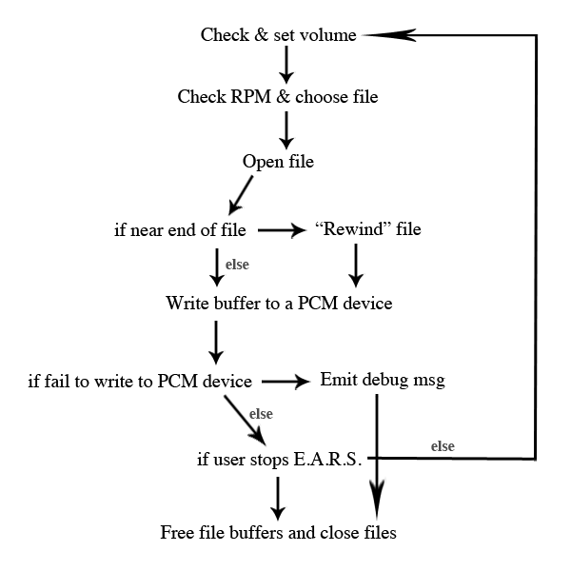
E.A.R.S
Originally coded in C# as a separate program
Microsoft DirectSound Library
Moved within the GUI program
ALSA Library
Within a thread
Notes:
The Ears was originally coded in C# separate to the GUI Program and used Mircrosoft’s DirectSound Library.
The Rpi is on a Linux System however and DirectSound is not able to be ported over. Thus it needs re-implementation.
The E.A.R.S is now coded within the GUI program using the ALSA(Advanced Linux Sound Architecture) Library.
It is coded to use a separate thread due to an continuous while loop in the code.

Slide 39
E.A.R.S
Notes:
After initialising the system and devices.
The first step of the loop is to check if the volume has been changed since the last iteration, and to set it if it has.
Then it will check if the RPM has changed since the last iteration, opening the corresponding file if it is not already open.
If the pointer to the file is near the end of the file the pointer will be pointed to the start of the file.
And then a buffer of a certain size from the file is written to the PCM device.
If this fails an error message is emitted, file buffers are freed and files closed.
Otherwise a check is run to see if the user has stopped the E.A.R.S. if not the loop re-iterates.
PCM= Pulse code modulation
Unfortunately the new implementation is not as realistic as the previous version.
The DirectSound library is able to shift the frequency of the audio being played. The sound files increment in engine speed every 100 rpm, without being able to shift the frequency the
Result is a discontinuous playback.

Slide 40
Conclusion
The GUI system was successfully shifted onto the RPi
The GUI has been optimised for both vehicles and standardised between the two
New functionalities have been added
E.A.R.S. has been ported to the Linux environment
Successfully implemented into both vehicles
Notes:
In conclusion, … …

Slide 41
Future work
I/O module
Further testing to objectively assess the current vs recommended interior setup
Continue work on the new E.A.R.S
Increasing RPi’s reliability
Moving the touch screen of the Lotus
Notes:
However, there still require more work to be done.
An I/O module is still needed to communicate to the vehicle’s states..
Further testing is required to assess the current interior setup versus the recommendations
More work on the E.A.R.S needs to be done, also to possibly look into other more active methods of pedestrian safety, such as avoidance or driver alerts.
The RPi currently, like the Eyebot, get its power cut when the ignition power is turned off. This could corrupt the SD Card, having said that the Rpi was designed without a power switch.
Lastly, the touch screen of the Lotus should be moved to the center of the dashboard.

Slide 42
Questions?
Notes:
Thank you for listening to my presentation, are there any questions?

